Slide 1
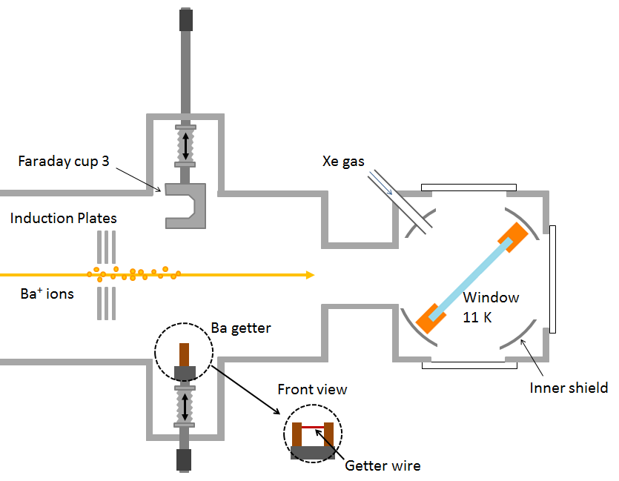
Ba⁺/Ba Deposition

Slide 2
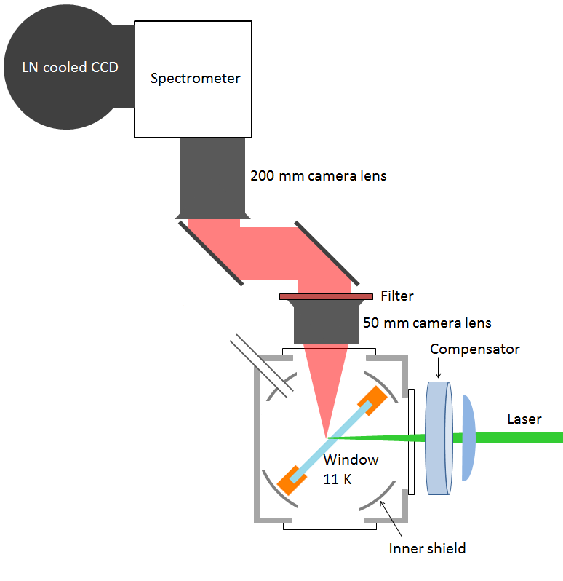

Slide 3
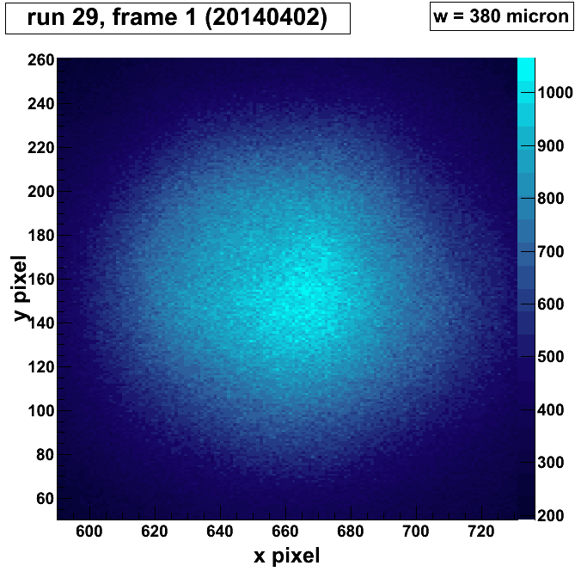
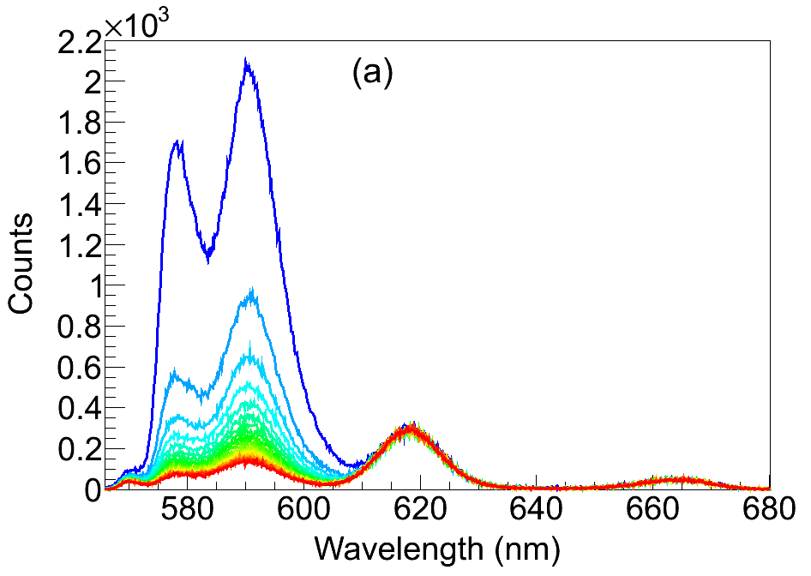
Image of fluorescence by semi-focused laser:

Slide 4
Summary: optimal conditions for observing Ba in SXe
1) Deposit at 50 ± 5 K, observe at 11 K

